Slide 1
Date-A-Scientist
By Srikandarajah Nallaiwickreman

Slide 2
Contents
Exploration of Datasets
Questions to Answer
Augmenting the DataSet
Classification Approaches
Regression Approaches
Conclusion

Slide 3
Exploration of Datasets

Slide 4
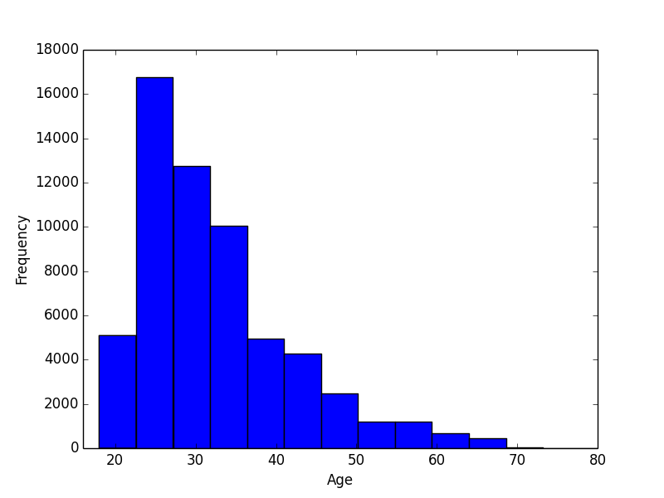
Distribution of Age

Slide 5
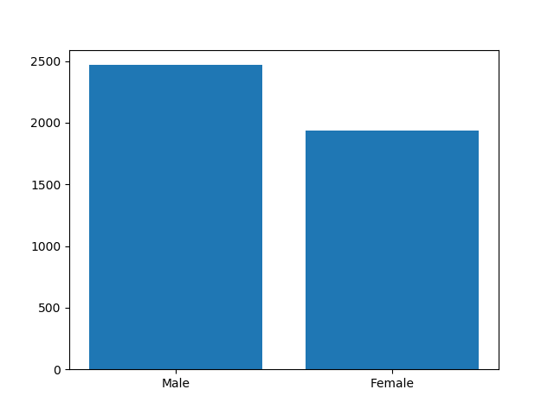
Male Vs Female

Slide 6
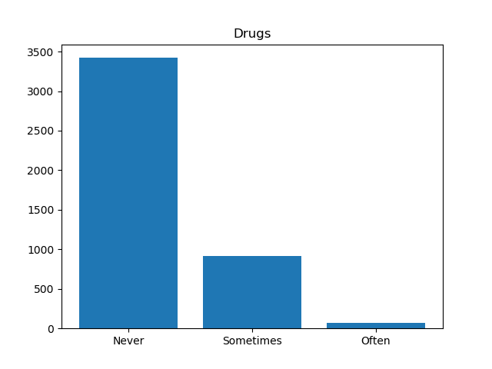
Usage of Drugs

Slide 7
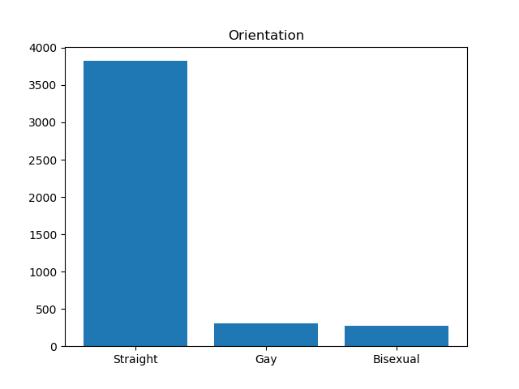
Orientation

Slide 8
Questions to Answer

Slide 9
Classification Techniques Questions
Can we predict sex with education level and income?
Can we predict education level with essay text word counts?

Slide 10
Regression Techniques Questions
Predict income with length of essays and average word length?
Predict age with the frequency of "I" or "me" in essays?

Slide 11
Augmenting the DATA

Slide 12
Mapping Categorical Data
We have transformed Drinks Column into Numerical Data
drinks | drinks_code |
|-------------|-------------|
| not at all | 0 |
| rarely | 1 |
| socially | 2 |
| often | 3 |
| very often | 4 |
| desperately | 5 |

Slide 13
Mapping Categorical Data
We have transformed Smoke Column into Numerical Data
smoke | smoke code |
|-------------|-------------|
| no | 0 |
| sometimes | 1 |
| when drinking | 2 |
| yes | 3 |
| trying to quit | 4 |

Slide 14
Mapping Categorical Data
We have transformed Drug Column into Numerical Data
drug | drug code |
|-------------|-------------|
| never | 0 |
| sometimes | 1 |
| often| 2 |

Slide 15
Classification Approaches

Slide 16
Zodiac Signs
To find out how Zodiac sign is depend on people’s habit, we ran two classiciation algorithms : K Nearest Neighbors & Support Vector Machines
For Zodiac Signs, we used following columns of data as features: Drink Code, Drug Code, Smoke Code, Average Essay Length, Average Word Length
In K Nearest Neighbors, after analying a lot of values of K, the highest accuracy score is 0.0574 and corresponding value for the K is 294
In Support Vector Machines, after analyzing a lot of values of Gamma, the higest accuracy score is 0.0687 and the corresponding Gamma value is 6.
For this anaysis, Support Vector Machines predict more accurate results

Slide 17
Prediction of Sex
To predict sex using education level and income, we ran two classiciation algorithms : K Nearest Neighbors & Support Vector Machines
In K Nearest Neighbors, after analying a lot of values of K, the highest accuracy score is 0.571 and corresponding value for the K is 26
In Support Vector Machines, after analyzing a lot of values of Gamma, the higest accuracy score is 0.560 and the corresponding Gamma value is 2.
For this anaysis, K Nearest Neighbors predict more accurate results than Support Vector Machines and it is a faster approach.

Slide 18
Prediction of Education Level
To predict education using essay text word counts, we ran two classiciation algorithms : K Nearest Neighbors & Support Vector Machines
In K Nearest Neighbors, after analying a lot of values of K, the highest accuracy score is 0.396 and corresponding value for the K is 34
In Support Vector Machines, after analyzing a lot of values of Gamma, the higest accuracy score is 0.394 and the corresponding Gamma value is 0.5.
For this anaysis, K Nearest Neighbors predict more accurate results and it is a faster approach.

Slide 19
Regression Approaches

Slide 20
Prediction of Income
To predict income using length of essays and average word length, we ran two regression algorithms : Multiple Linear Regression & K-Nearest Neighbors Regression
In Multiple Linear Regression, the accuracy score is -0.00041
In K-Nearest Neighbors Regression , the accuracy score is -0.54
For this anaysis, Multiple Linear Regression predict more accurate results and it is a faster approach.

Slide 21
Prediction of Income
To predict income using length of essays and average word length, we ran two regression algorithms : Multiple Linear Regression & K-Nearest Neighbors Regression
In Multiple Linear Regression, the accuracy score is -0.00041
In K-Nearest Neighbors Regression , the accuracy score is -0.54
For this anaysis, Multiple Linear Regression predict more accurate results and it is a faster approach.

Slide 22
Prediction of AGE
To predict Age using frequency of words in essay, we ran two regression algorithms : Multiple Linear Regression & K-Nearest Neighbors Regression
In Multiple Linear Regression, the accuracy score is -0.00021
In K-Nearest Neighbors Regression , the accuracy score is -0.55
For this anaysis, Multiple Linear Regression predict more accurate results and it is a faster approach.

Slide 23
Thank you
Thanks for reviewing my project and providing feedback.

